Slide 1
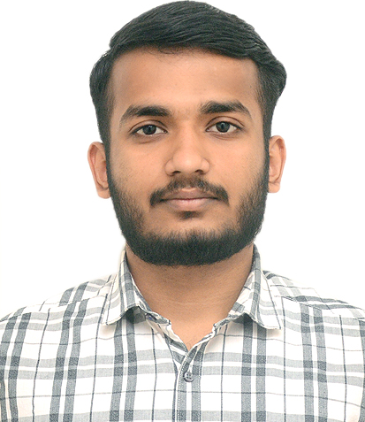



Jayant Tyagi
Bachelor of Technology
Electronics and Communication Engineering: 2018 - 2022
Analyst/Software Engineer
Skills
Bangalore
Java 8 /J2EE | Java Basics, OOPS, Generics, Collections, Arrays, Loops, Lambda Exp, Stream API, Junit, Servlets & Exception Handling.
Spring core | IOC & Dependency Injection, Autowire.
Spring REST | REST controllers, Implementation of GET, POST, PUT & DELETE, Bean Validation, Testing Services, Controller & Repository layer.
Spring Data JPA | Implement DAO layer using spring Data repositories, Transaction Management
Spring Boot Microservices | Microservice Architecture, Spring Boot Starters, annotations, Messaging Service, Swagger API documents
Spring Cloud | Eureka Server & API Gateway
React | Components, Routes, Event handling, Axios, Bootstrap CSS
Database | MongoDB, MySQL
UI Tech | HTML 5 & CSS 3, JavaScript, Reusable templates, Optimized UI Designed
Tools | Git, Postman, Maven, IDE
Devops | CI/CD, Jenkins configuration, Build Pipelines, Docker
Add On skills | Communications, Team management. Peer learning, Agile learner
jayant.tyagi@capgemini.com
+91 9582533534
A4
Full Stack Developer
Hands on experience in creating microservices with Springboot, Spring Security, Spring Cloud API Gateway, Eureka server, load balancing and Logger.
Proficient in creating Single page Web Application in ReactJs with Axios, Routes, Bootstrap CSS, Components, Authentication and Event handling.
Hands on experience in implementing polyglot architecture with ReactJs & spring boot.
Experience in :- creating documentation with swagger; unit testing using Junit; RabbitMq for internal messaging (Notifications); SMTP for Email service.
Development experience in creating docker compose files, docker images and pushing to Docker Hub.
Understanding of AWS Cloud environment
ONLINE HOTEL MANAGEMENT SYSTEM
Completed end to end case study of Hotel Management System along with JWT authentication, Swagger and Payment gateway using Paytm, RabbitMQ, SMTP, Logger, Responsive UI with Bootstrap CSS and React used for user interface.
WASTE SEGREGATION USING IOT
Made a working project that segregates wet and dry waste into separate bins using different sensors which includes Moisture Sensor , Ultrasonic Sensor , IR Sensor which are connected to Arduino.
CAMP TRAINING in Capgemini on JEE with DevOps and AWS
AWS Certified Cloud Practitioner
Check out my work on GitHub & Video Profile

